Slide 1
Environmental Protection

Slide 2
We live in a world full of different types
of pollution

Slide 3
Wanting to make their lives easier people have invented so many new devices and factories, that nature is in danger

Slide 4
Unfortunately, environment is not the unlimited source of resources

Slide 5
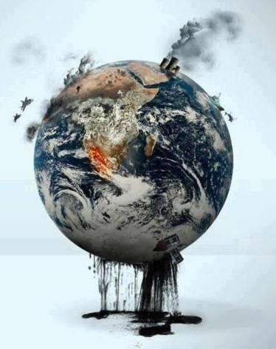
At the moment, our planet suffers from numerous problems and damages

Slide 6
Many species of animals and plants start to disappear

Slide 7
Forest damages

Slide 8
Water shortage

Slide 9
Wildlife suffers as well

Slide 10
Problem with smoking

Slide 11
It is all the result of pollution that comes from factories and plants

Slide 12
People should start dealing with these problems immediately

Slide 13
Thank you

