Slide 2
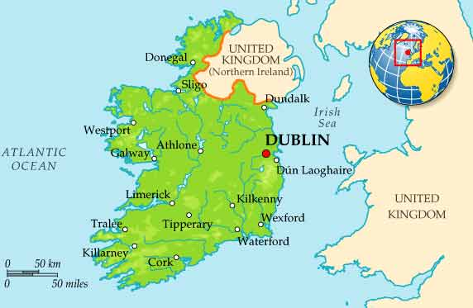
Ireland is a beautiful green country located in northwest Europe. It is an island that is separated from Great Britain by the Irish Sea

Slide 3
Its flag is a horizontal flag with green, white and orange vertical stripes

Slide 4
The island is considered the 20th largest island in the world, and encompasses 84,421 kilometers squared of land.

Slide 5
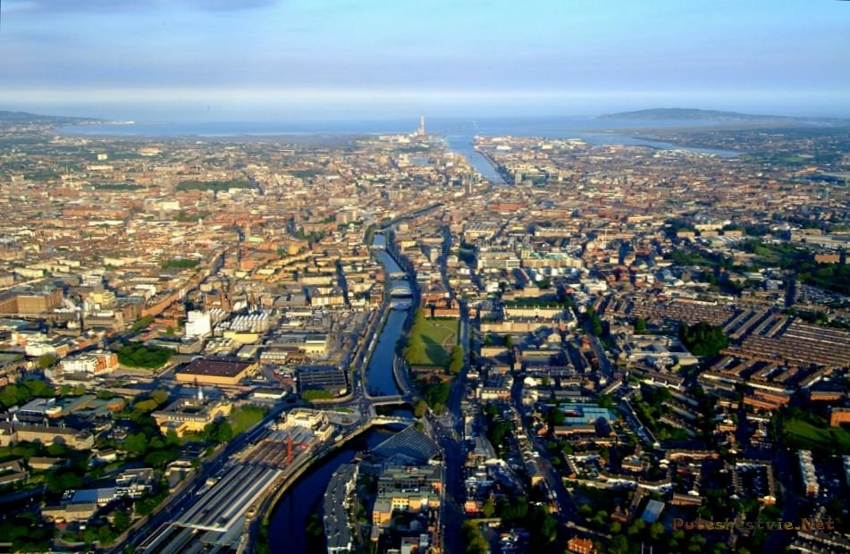
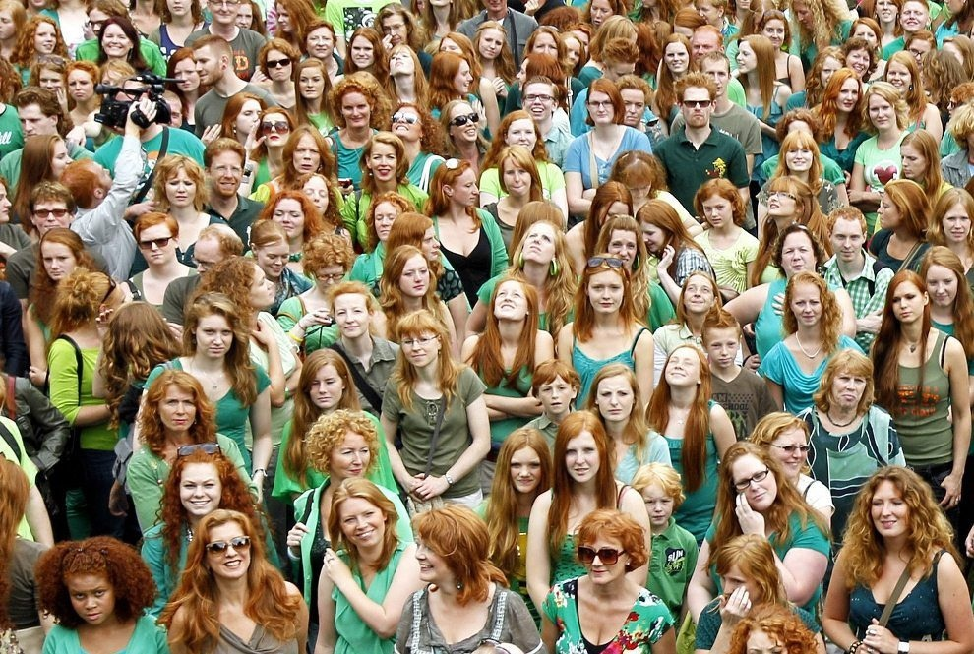
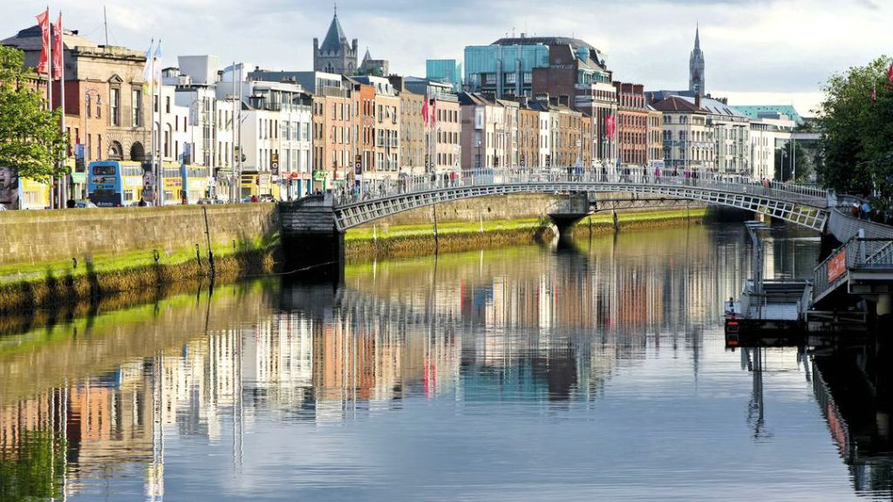
It is home to 6.4 million people, and the capital city of Dublin has a population of 1.273 million people

Slide 7
Ireland is known as the Emerald Isle, this is because of its lush greenery and rolling hills. The country receives a lot of rain each year, which keeps the grass green and the plants blooming

Slide 8
The three most famous symbols of Ireland are the green Shamrock, the harp, and the Celtic cross

Slide 9
Ireland has had its own Olympics since the Bronze Age

Slide 10
Ireland is a snake-free island. Due to its isolation from the European mainland, Ireland lacks several species common elsewhere in Europe

Slide 11
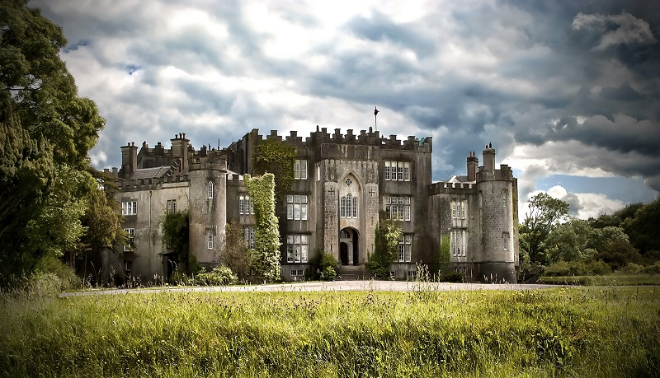
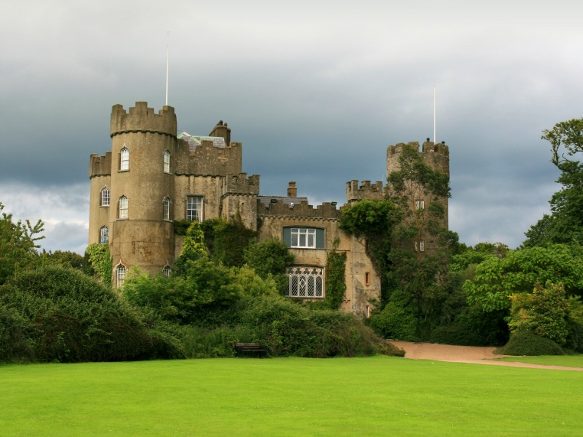
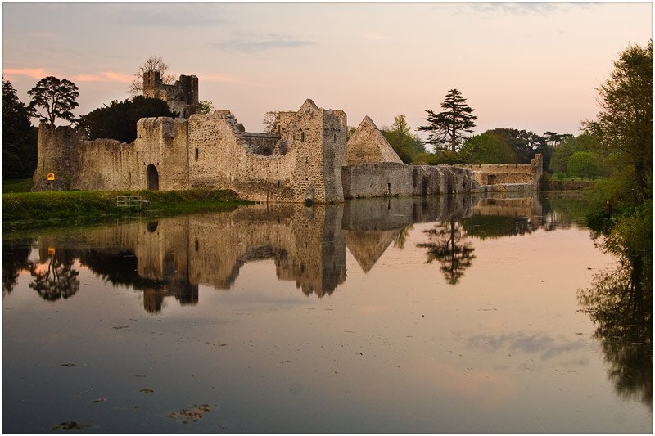
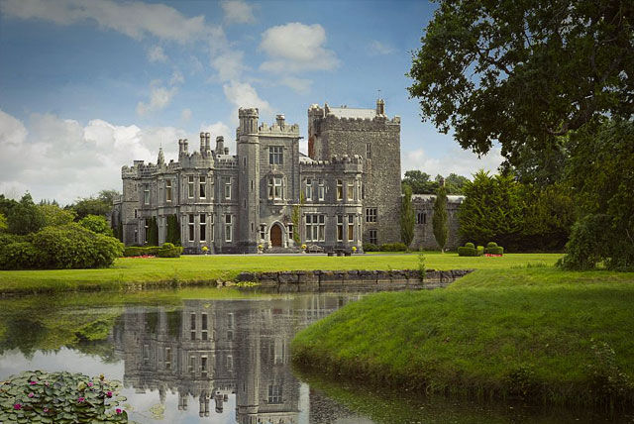
Ireland is known throughout the world for its vast amount of castles. Ireland’s history is dotted with wars and violence, so castles were built to protect families from invaders. Today, most of the castles are still standing and some can even be visited by tourists

Slide 12
The story of the world-famous vampire Count Dracula was written in 1897 by Bram Stoker, from Dublin

Slide 13
Thank you

