Slide 1
St. Valentine’s Day

Slide 2
Valentine’s Day, also called St. Valentine’s Day, holiday (February 14) when lovers express their affection with greetings and gifts.

Slide 3
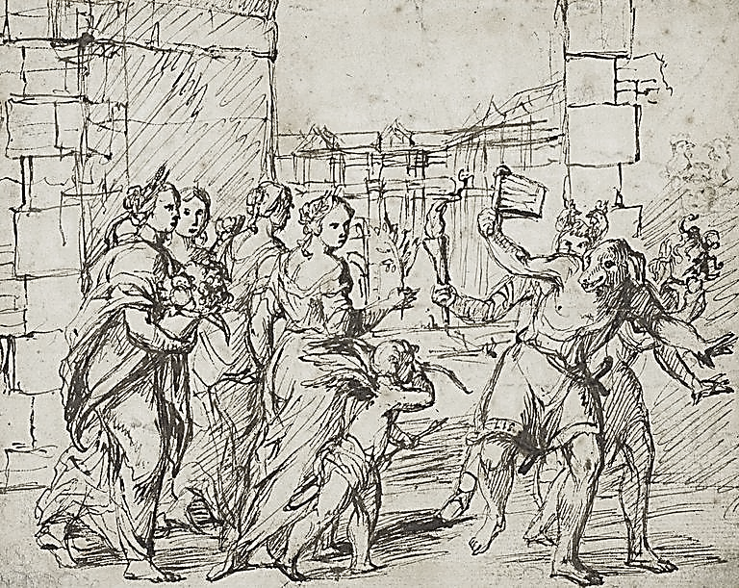
The holiday has origins in the Roman festival of Lupercalia, held in mid-February. At the end of the 5th century, Pope Gelasius I replaced Lupercalia with St. Valentine’s Day. It came to be celebrated as a day of romance from about the 14th century.

Slide 4
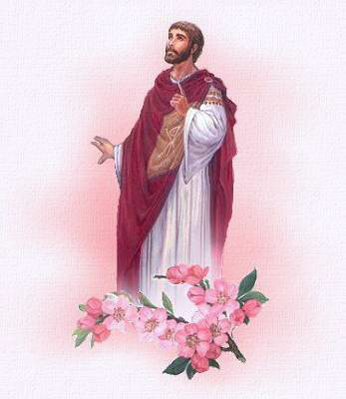
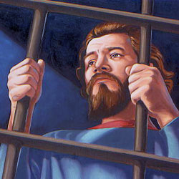
Although there were several Christian martyrs named Valentine, the day may have taken its name from a priest who was martyred about 270 CE by the emperor Claudius II Gothicus.

Slide 5
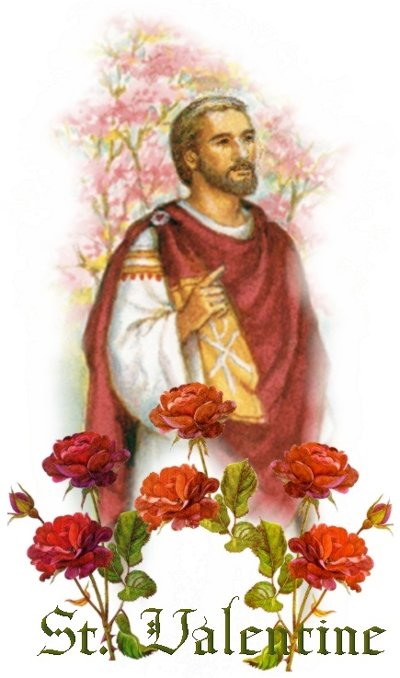
According to legend, the priest signed a letter “from your Valentine” to his jailer’s daughter, whom he had befriended and, by some accounts, healed from blindness.

Slide 6
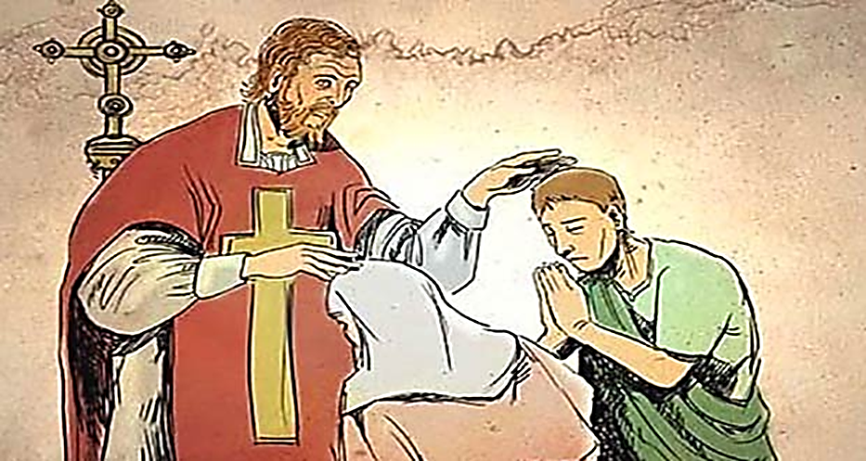
Another common legend states that St. Valentine defied the emperor’s orders and secretly married couples to spare the husbands from war. It is for this reason that his feast day is associated with love.

Slide 7
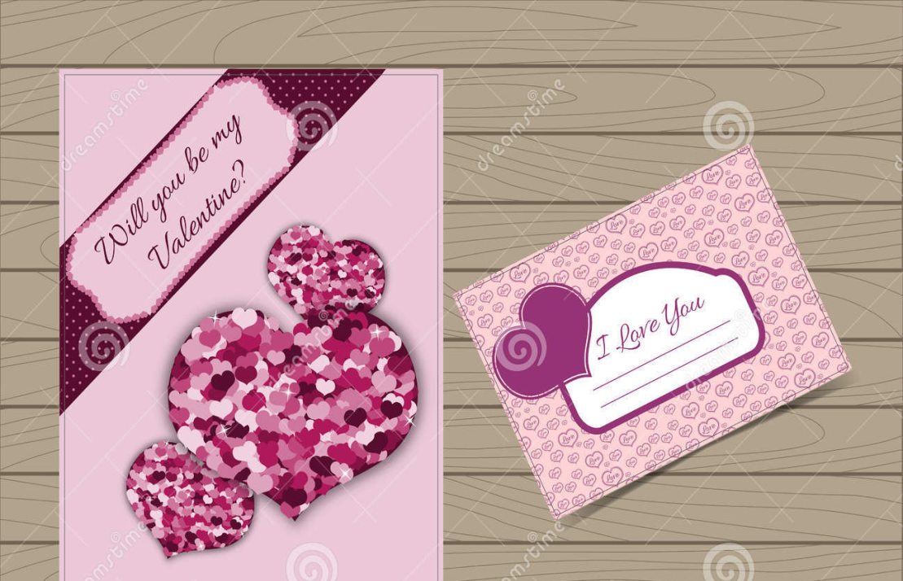
Valentines
Formal messages, or valentines, appeared in the 1500s, and by the late 1700s commercially printed cards were being used.

Slide 8
Valentines commonly depict Cupid, the Roman god of love, along with hearts, traditionally the seat of emotion.

Slide 9
Traditional gifts include candy and flowers, particularly red roses, a symbol of beauty and love.

